Slide 1


Good morning every one !!!

Slide 2

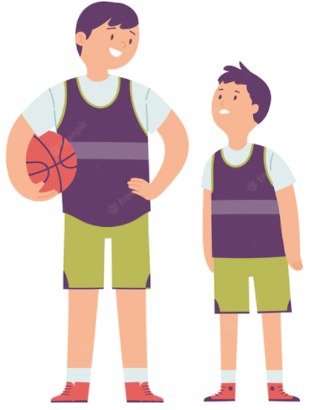
WARM-UP
GAME: BRAINSTORMING
big
ADJECTIVES
heavy, light, cheap, expensive, boring, interesting, fun, thin, fat, tall, short, handsome, ugly, etc.

Slide 3
WARM-UP
GAME: BRAINSTORMING
“The boy on the left is taller than the boy on the right.”

Slide 4




Unit
4
MUSIC AND ARTS
LESSON 3: A CLOSER LOOK 2
*Grammar: Comparisons: like, different from, (not) as … as
Unit
HOBBIES

Slide 5
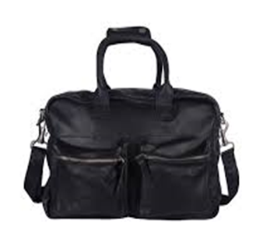
* Grammar:
COMPARISONS (so sánh)
A
B
Bag A is like bag B
(to)be like : giống nhau ( tương đồng)

Slide 6
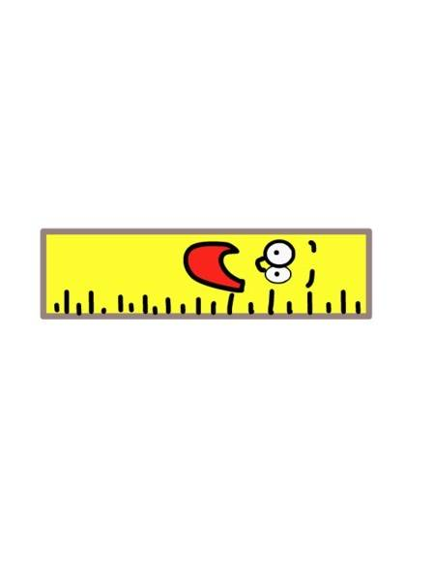
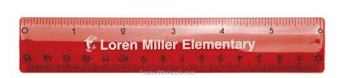
* Grammar:
COMPARISONS (so sánh)
(long)
1. The yellow ruler is _____________ the red ruler.
as long as
=> as + adj + as: so sánh hai vật ngang bằng nhau
=> not + as + adj + as: so sánh vật này “hơn” hoặc
“kém” vật kia.

Slide 7
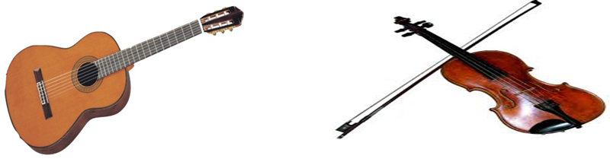
guitar
violin
4. The guitar is different from the violin
(to)be different from... => dùng để so sánh sự khác nhau giữa 2 chủ thể.

Slide 8
* COMPARISONS
(to) be like + N/ Pronoun
(not) as + adj + as
(to) be different from

Slide 9
* PRACTICE
1
Write like, as, or different in the gaps.
This camera is not as expensive _______ I thought at first.
Her room is lovely. It is ________ a princess’s room.
You like folk songs; I like pop music. Your taste is __________ from mine.
My dad is not always as busy _______ my mum.
Some of us think that Spiderman 2 is not too __________ from Spiderman
as
like
different
as
different

Slide 10
2
Finish the second sentence in each pair, using like, as … as, or different from.
1. Rock is very exciting. It is not like country music.
Rock is very ________________ country music.
2. Composer Hoang Long wrote many good songs for children. Composer Pham Tuyen also wrote many good songs for children.
→ Composer Hoang Long, ___________ Pham Tuyen, wrote many good songs for children.
3. The Vatican Museum has excellent works of art. The Louvre Museum has excellent works of art too.
The Vatican Museum ‘s works of arts are __________ excellent _________ the Louvre Museum’s works of art.
4. A vacation on the beach is relaxing, while a vacation in a big city may not be.
→ A vacation on the beach is ______________ a vacation in a big city
5. City life is busy, but country life is peaceful.
→ City life is not ____________ peaceful ___________ country life.

Slide 11




4
5
3
6
7
1
2
LUCKY APPLES?

Slide 12
2
Finish the second sentence in each pair, using :
like, as … as, or different from.
1. Rock is very exciting. It is not like country music.
Rock is very ________________ country music.
different from

Slide 13
2
Finish the second sentence in each pair, using :
like, as … as, or different from.
2. Composer Hoang Long wrote many good songs for children. Composer Pham Tuyen also wrote many good songs for children.
→ Composer Hoang Long, ___________ Pham Tuyen, wrote many good songs for children.
like

Slide 14
2
Finish the second sentence in each pair, using :
like, as … as, or different from.
3. The Vatican Museum has excellent works of art. The Louvre Museum has excellent works of art too.
The Vatican Museum ‘s works of arts are __________ excellent _________ the Louvre Museum’s works of art.
as
as

Slide 15
2
Finish the second sentence in each pair, using :
like, as … as, or different from.
4. A vacation on the beach is relaxing, while a vacation in a big city may not be.
→ A vacation on the beach is ______________ a vacation in a big city
different from

Slide 16
2
Finish the second sentence in each pair, using :
like, as … as, or different from.
5. City life is busy, but country life is peaceful.
→ City life is not ___________ peaceful __________ country life.
as
as

Slide 17


YOU GET A GIFT

Slide 18
YOU GET A GIFT

Slide 19
2
Finish the second sentence in each pair, using like, as … as, or different from.
1. Rock is very exciting. It is not like country music.
Rock is very ________________ country music.
2. Composer Hoang Long wrote many good songs for children. Composer Pham Tuyen also wrote many good songs for children.
→ Composer Hoang Long, ___________ Pham Tuyen, wrote many good songs for children.
3. The Vatican Museum has excellent works of art. The Louvre Museum has excellent works of art too.
The Vatican Museum ‘s works of arts are __________ excellent _________ the Louvre Museum’s works of art.
different from
like
as
as
4. A vacation on the beach is relaxing, while a vacation in a big city may not be.
→ A vacation on the beach is ______________ a vacation in a big city
5. City life is busy, but country life is peaceful.
→ City life is not ____________ peaceful ___________ country life.
different from
as
as

Slide 20


3
Compare the two museums: History and Science, using like, as … as, or different from.
 | History | Science
1. modern | ** | ***
2. friendly | *** | ***
3. safe | *** | **
4. expensive | ** | **
as
as
1.History is not ……………. modern ……………. Science.
as
as
2. History is ………….. friendly ….. Science.

Slide 21
4
Rewrite the sentences, using the words given at the beginning.
1. I think action films are more interesting than comedies.
I think comedies are not ________________________________.
2. Our maths homework is more difficult than our history homework.
→ Our history homework is not ______________________________.
3. This year’s music contest is different from last year’s.
→ This year’s music contest is not ______________________________.
4. The characters in the film are not the same as the ones in the play.
The characters in the film are ________________________________.
5. This picture is brighter than that picture.
→ That picture is not ________________________________.
as interesting as action films
as difficult as our maths homework
like last year’s
different from the ones in the play
as bright as this one

Slide 22
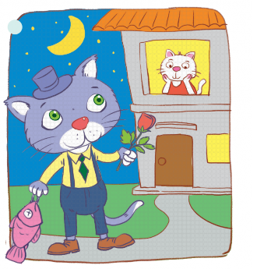
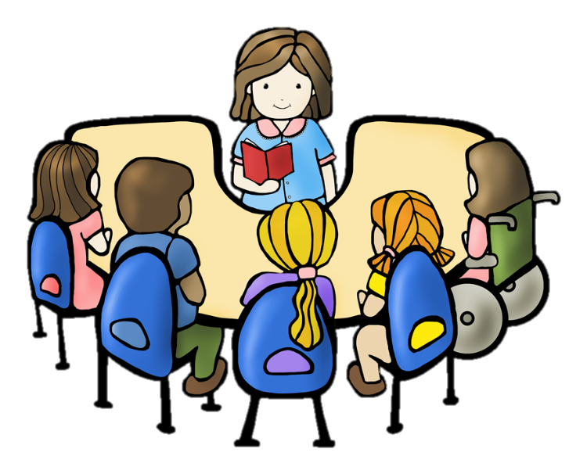
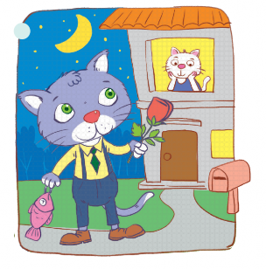
* PRODUCTION
5
Look at the two pictures and compare them, using like, as … as, or different from.

Slide 23
* PRODUCTION
5
Look at the two pictures and compare them, using like, as … as, or different from.
- Picture A is not as big as picture B.
- The cat in picture A is different from the cat in picture B.
- The cat in the house in picture A is like the cat in the house in picture B.
- The fish in picture A is not as big as the fish in picture B.
- The flower in picture A is not as small as the flower in picture B.

Slide 24
* CONSOLIDATION
Grammar: Comparisons: like, different from, (not) as … as

Slide 25
* Homework
Do exercises in the workbook.
Prepare: Communication.

Slide 26
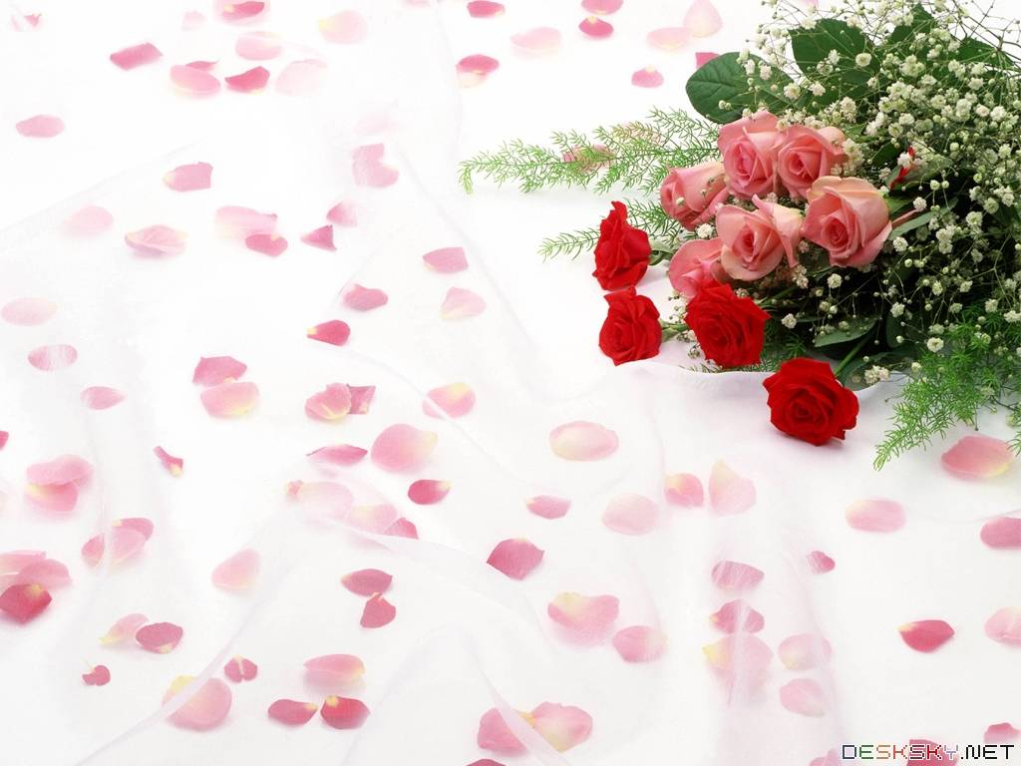
Thank you!
Have a nice day!

Slide 27

* Grammar:
COMPARISONS
→ The yellow pencil is not as long as the orange one.
→ The pen is as long as the orange pencil.

Slide 28
* COMPARISONS
→ The pen is different from the yellow pencil.

Slide 29
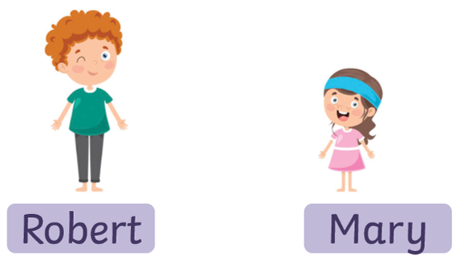

COMPARISONS
→ Robert’s pencil case is like Mary’s pencil case.

